Slide 1
The Long Jump to Build Epic Printers in Soft
Presented by Michael Camp & James Shin

Slide 2
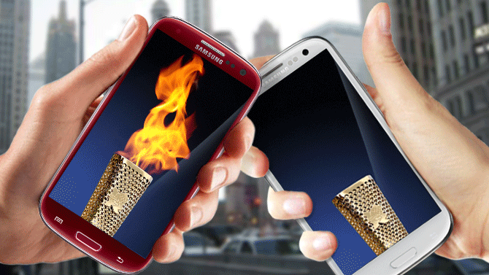
Epic Passed the printing torch

Slide 3
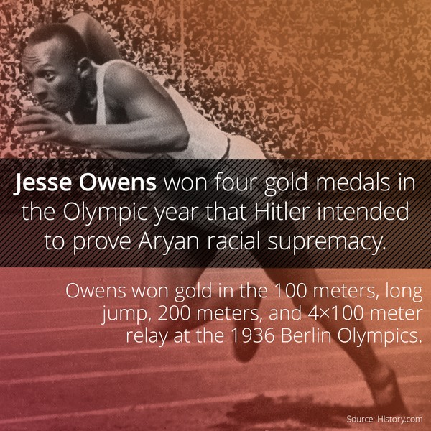
Leaping towards success
Jesse Owens
In 1936 he leaped 8.06 m (26.44 ft). This record stood for 25 years. Building Epic printers felt like we were just like Jesse Owens, soaring through the air.

Slide 4
Quick OverView of JHH Printing
Approximately 3,000 printers built in Soft and VPSX – (Lab and Epic)
Around 1,700 are USB Tethered to a computer
Zebra Printers are used for nursing floor printing
A majority of the lab printers are Datamax (3 different models)

Slide 5
How are Epic printers connected?

Slide 6
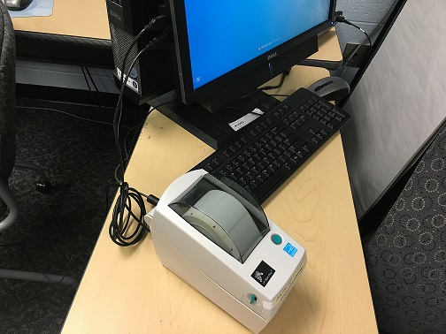
3 types of epic printer connections
USB Tethered Printer
Epic’s most common connection
Requires that you know the Computers host name and Domain
Installations of VPSX windows client on computer
1700 Epic printers installed this way

Slide 7
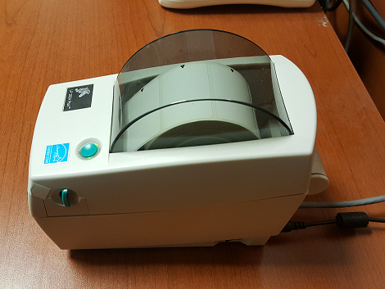
3 types of epic printer connections
Ethernet(IP) connected
Epic’s second most common connection at JHH
Requires IP of printer device
1000 Lab/Epic printers setup this way

Slide 8
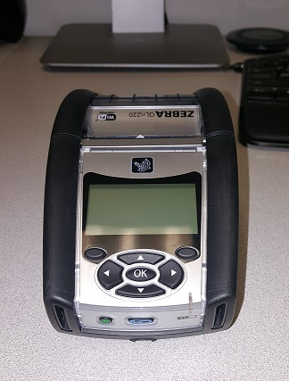
3 types of epic printer connections (Cont.)
Wireless Connection
Requires ip of printer device
Hostname can be used to stabilize internet on the device. (Used when internet drops from device because of Access point transfers) Switching of subnets
JHH has 250 of these Epic printers in operation

Slide 9
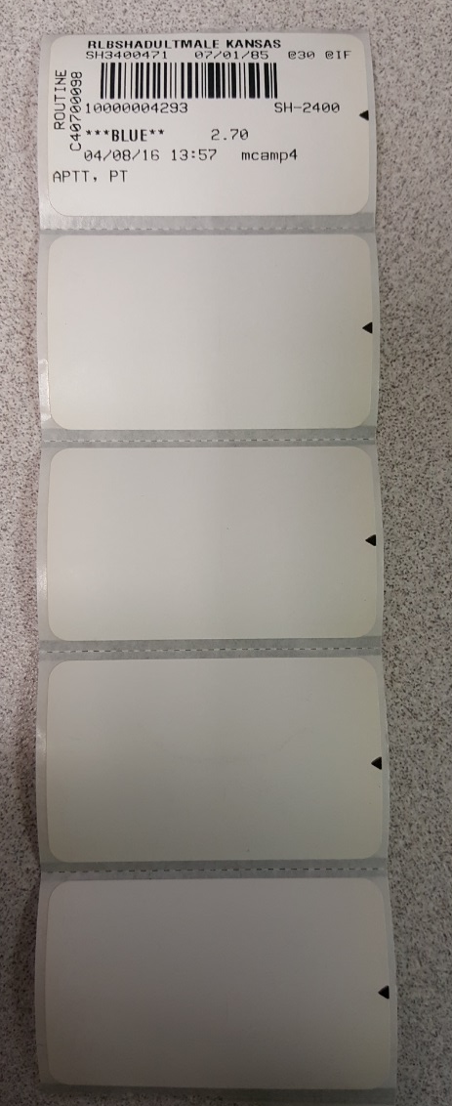
Zebra Label configuration
Every wireless zebra printer had to be updated with a soft configuration file.
This prevented the zebra printer from printing 4 blank labels with each order
^XA ^LT-030 ^JUS ^XZ

Slide 10
Soft/VPSX setup up for the Epic Printers

Slide 11
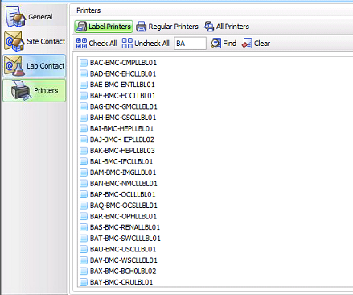
EPIC PRINTERs within SOFt SECURITY
Printers do not need to be checked off in Soft Security. For troubleshooting purposes they are checked off to send a label across from Soft.

Slide 12
Label naming changes
Initially all of the Soft printers were setup with in VPSX with an underscore _.
BAA_BMC_Burnunit
Epic could not accept the underscore and needed us to replace it with a Dash –
BAA-BMC-Burnunit

Slide 13
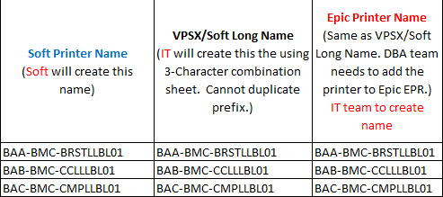
Naming Format
using
Spread sheet shared by Soft/Epic and IT department
IT played a vital part on getting all of the Printer information

Slide 14
Lab Naming convention used
a numerical character first for lab, unique to the hospital
Johns Hopkins Ex. 1AA – JHH Lab
Suburban, ex. 2AA – Suburban Lab
Bayview , ex. 3AA - Bayview lab
Sibley, ex. 4AA – Sibley Lab
Howard, ex. 5AA - Howard Lab

Slide 15
Epic Naming convention used
an alpha character would be first for Epic printers, unique to the hospital
Johns Hopkins Ex. jAA/kAA – JHH Lab
Suburban, ex. sAA – Suburban Lab
Bayview , ex. bAA - Bayview lab
Sibley, ex. mAA – Sibley Lab
Howard co., ex. HAA - Howard co. Lab

Slide 16
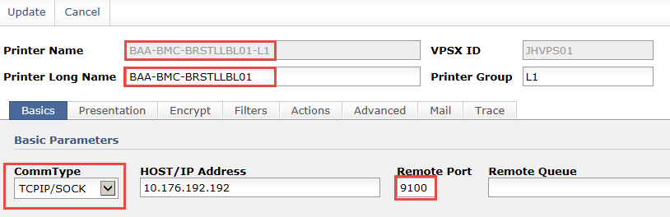
VPSX SETUP
IP connected Setup
Keep the Printer Name and Printer Long name the same
Have the correct CommType for correct IP Address.
The Remote Port should be adjusted for the connection setup

Slide 17
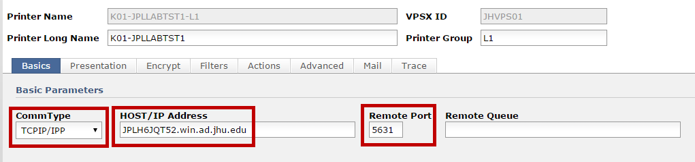
VPSX SETUP
Hostname/domain name setup
Keep the Printer Name and Printer Long name the same but add the Printer Group to the printer name
IPP should be used for Host/Domain configuration. It can be encrypted and allows access control.
The Remote Port should be 5631 for the connection setup

Slide 18
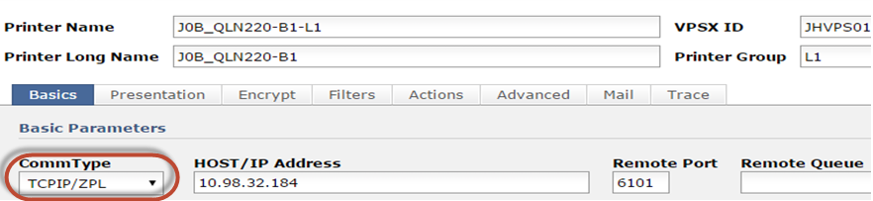
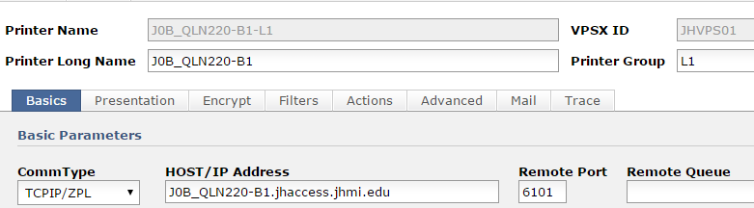
VPSX SETUP
WIRELESS Connected Printers
CommType should be ZPL for all Zebras and Port 6101 is used for all wireless devices.

Slide 19
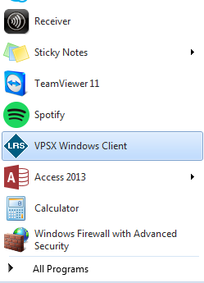
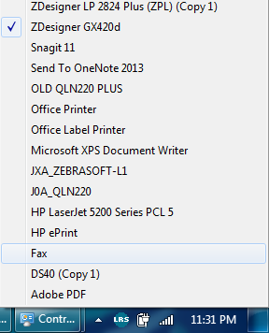
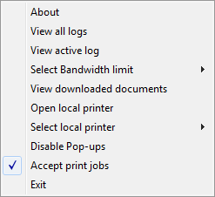
Installation of vPSx WINDOWS Client

Slide 20
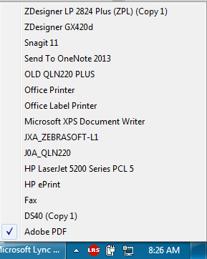
Troubleshooting vPSx WINDOWS Client
Please make sure all printers and devices are turned on.
Virtual printer selected
FAIL
Client deactivated

Slide 21
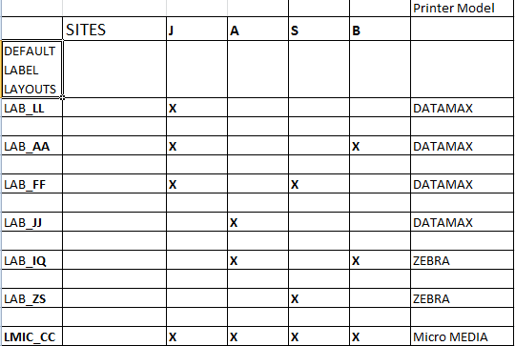
Additional changes
Remove unused printers formats
We have 7 different label formats but would like to make it one or two. We will be exchanging all of the Datamax printers for Zebra printers.

Slide 22
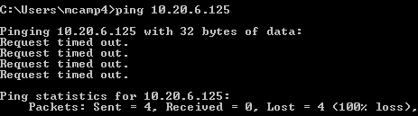
Trouble Shooting printing issues
Check if device is on.
Check if device cable is plugged in to port/USB.
Check if to see IP/Hostname has changed by Pinging the IP/Hostname.
Check the VPSX client and assure it is active.
Check the VPSX client to assure it has the correct printer selected

Slide 23
How Epic users send prints

Slide 24
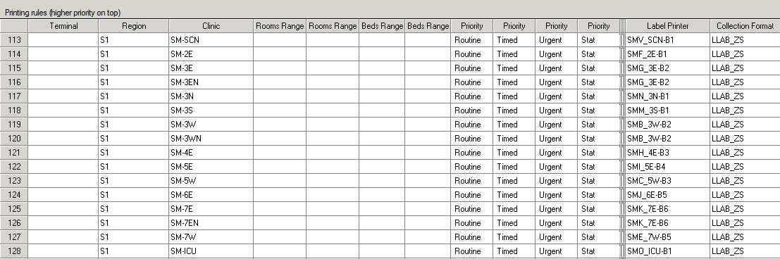
LABEL SETUP TABLE (TTY PRINTING)
Epic printers were setup in Soft under the Label setup table with Soft

Slide 25
Label setup table benefits
Easy to setup within Soft takes minutes
Some modification to interface is needed
Printing is contained within Soft
Required little additional setup from epic builders (TTY Names for Terminal)
Epic Users cannot select the incorrect printer

Slide 26
Label SETUP TABLE ISSUES
Takes ~30 to 60 Seconds for a label to print (very consistent)
If a label printer broke the nursing unit didn’t have another Printer to switch to.
Patient’s would change wards and the labels would print to the correct location

Slide 27

Epic’s New way of printing
We removed the epic printers from the label printing setup for a user selection printing option.
Similar to Soft’s User selection printing

Slide 28
Benefits of user selection Printing
User can print to any printers in the list
Works great with mobile handheld printers
Patient ward changes didn’t affect where labels would print

Slide 29
Issues with Epic user selection Printing
Delays in label printing due to interface message hisoe(10 seconds to 7 minutes)
Users selecting incorrect printers
Users scanning barcode before messages are sent from Epic to soft back to epic
Users not having the printer on in order to get labels

Slide 30
Issues with Epic user selection printing
7 minute labels Prints
REALLY?!?!?
The Cause?
Epic’s morning draw released at 00:35 consisted of 1600 orders sending to Soft at once

Slide 31
Issues with Epic user selection printing
Barcodes that took more than 60 seconds to print for Epic users

Slide 32
Issues with Epic user selection printing
Time of day | # >60 sec | %
00:00-00:34 | 72 | 2.12%
0:35 | 1619 | 47.65%
00:36-00:40 | 155 | 4.56%
00:41-01:00 | 170 | 5.00%
1:00 | 101 | 2.97%
2:00 | 77 | 2.27%
3:00 | 132 | 3.88%
4:00 | 84 | 2.47%
5:00 | 62 | 1.82%
6:00 | 46 | 1.35%
7:00 | 24 | 0.71%
8:00 | 51 | 1.50%
9:00 | 39 | 1.15%
10:00 | 98 | 2.88%
11:00 | 49 | 1.44%
12:00 | 69 | 2.03%
13:00 | 59 | 1.74%
14:00 | 74 | 2.18%
15:00 | 72 | 2.12%
16:00 | 41 | 1.21%
17:00 | 68 | 2.00%
18:00 | 45 | 1.32%
19:00 | 31 | 0.91%
20:00 | 64 | 1.88%
21:00 | 34 | 1.00%
22:00 | 40 | 1.18%
23:00 | 22 | 0.65%
Total | 3398 | 100.00%

Slide 33
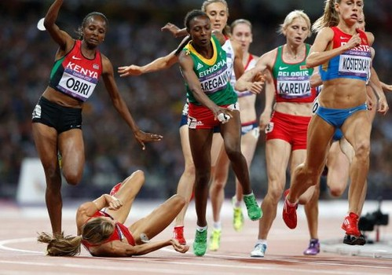
Printing Jobs falling to the wayside

Slide 34
The Interface printing line
The Famous Epic Print Button
Soft Epic Receiving Interface (1)
Soft HISOE
Interface (1)
Soft Label Server Interface (2)
Specimen Label Prints
Designated Epic Label Printer
VPSX

Slide 35
Epic Printers are defined in ORC-18 Within HISOE
14:57:38.433 read fd=14 <\11/MSH|^~\\&|EPIC|JHM|JHH SOFT|ALAB|20160330145733|EPI
C-IPRN|ORM^O01|6000991537|T|2.3|||\rPID|1||SH3400519^^^&1.2.840.114350.1.13.331.
2.7.2&ISO^^&1.2.840.114350.1.13.331.2.7.2&ISO|E100124225|RLBTEST^PATIENTD|HELEN^
^^|19820101|F|||1928 LANCASTER ST^^BALTIMORE^MD^21202^USA|30|(479)879-8898|||M||
2000316072|767867878||Tstmom^Helen^^|||||||||||\rPV1||I|SH-4300|||^^|James Shin^^^^^^^^^^NPI|1114953346^James^SHin||IM|||||||1467408864^ABBASI^
ABDUL^^^^^^^^^^NPI||2000316072|||||||||||||||||||||||||20151216164400||||||\rORC
|NW|8554370^EPC||2000316072|||^Once^^20160330145700^20160330^R^^Standing^^^^1||2
0160330145701|IPRN||James Shin^^^^^^NPI&2.16.840.1.113883.4.6&ISO^^
^^NPI|SH-4300&SH ADULT MEDICAL 4300&OBDEPID^^^110500^^^^^|(301)768-0552^^^^^301^
7680552||||BAA-BMC-BRSTLLB|||||||||||I|VERBAL WITH|||\rOBR|1|8554370^EPIC^1.2.840.
114350.1.13.331.2.7.2^ISO||CNTU^CHLAMYDIA / N.GONORRHOEAE / TRICH COMBO NAT, URI
NE^SHSOFTEAP^^CHLAMYDIA / N.GONORRHOEAE / TRICH COMBO NAT, URINE||20160330145700
|||||O||||URINE,OTHER^^^|1467408864^ABBASI^ABDUL^^^^^^^^^^NPI|(301)768-0552^^^^^
301^7680552|||||||Lab|||^Once^^20160330145700^20160330^R^^^^^^1|||||||||20160330
145700|||||||||\r\28/> len=1184

Slide 36
Hisoe Interface delay
The 1600 epic label prints were being delayed in the HISOE interface.
only one HISOE interface was processing the messages.
Routing orders to 10 HISOE by ENDING MRN NUMBER

Slide 37
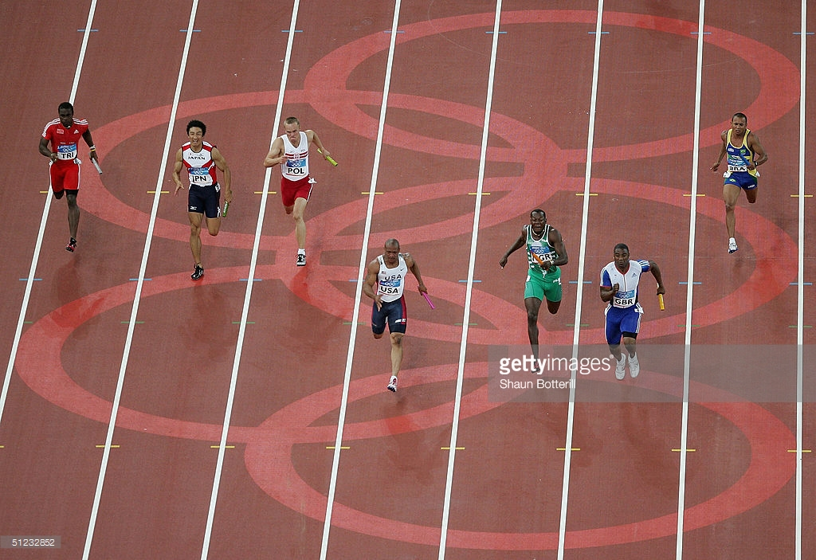
Printing jobs were Routed to the correct HISOE lane

Slide 38
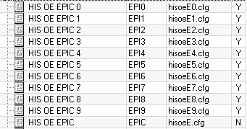
HISOE INTERFACE Delay
The Solution for hisoe delay
routing orders to 10 different HISOE interfaces based on the ending MRN number

Slide 39
Routing HISOE Interface
Pre HISOE FIX
Post HISOE FIX
Send to file | # of Labels | %
<=30 sec | 11178 | 71.91%
31-60 sec | 2277 | 14.65%
1-2 min | 535 | 3.44%
2-5 min | 332 | 2.14%
>5 min | 1222 | 7.86%
Total | 15544 | 100.00%
Send to file | # of Labels | %
<=30 sec | 7781 | 73.81%
31-60 sec | 1536 | 14.57%
1-2 min | 340 | 3.23%
2-5 min | 188 | 1.78%
>5 min | 697 | 6.61%
Total | 10542 | 100.00%

Slide 40
Today’s Epic printing time
<30 seconds on ~99% of label prints
>31 seconds 1% of labels prints due to outliers such as
  User not having printer on or plugged in
  The order is locked by the user making modifications

Slide 41
Lessons learned
Try to do a stress test to ensure that interfaces can handle bulk labels
  Soft’s Mom might need to be adjusted to handle more messages
Test each printer connection setup
  VPSX windows client should be tested with VPN and without VPN
Spot check/test VPSX before doing a bulk load
  Any information can be wrong leading to thousands of manual corrections (I.E. REMOTE PORT)
Spot check/test printers (Soft Security)
  Extra characters or spaces can cause printers to not work

Slide 42
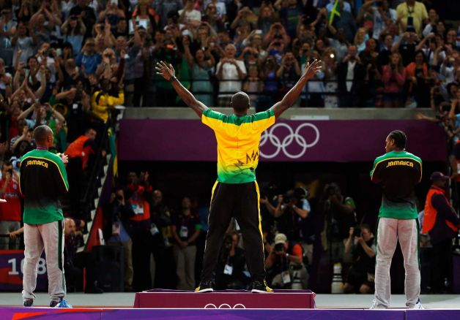

Questions

